Slide 1
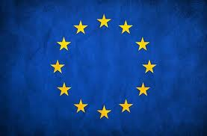
The European Countries
Authors: Kacper Frydrych
Karol Brożek
Bartłomiej Kurylak

Slide 2
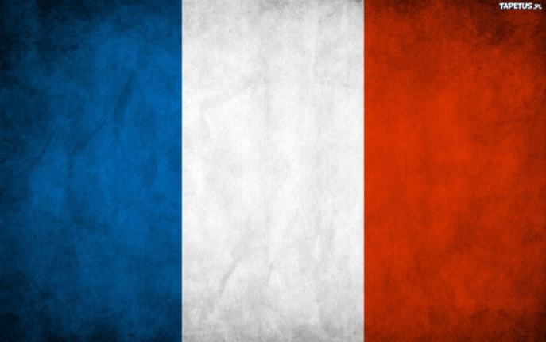
France
A country whose metropolitan territory is located in Western Europe with several overseas territories located in other continents. Metropolitan France extends from the Mediterranean Sea to the English Channel and the North Sea, and from the Rhine to the Atlantic Ocean. The French often referred to as l'cube - it comes from the shape of its territory.
Capital is Paris

Slide 3
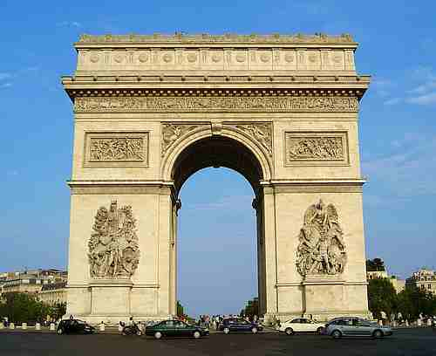
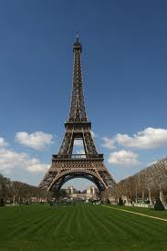
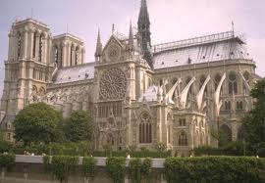
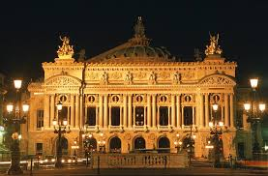
Points of interest in France
Arch of Triumph
Eiffel Tower
Notre-Dame Cathedral
Opera Garnier

Slide 4
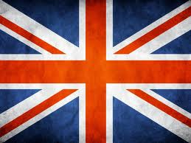
Great Britain
A sovereign state located in Western Europe. The United Kingdom consists of England, Wales and Scotland located on the island of Great Britain, Northern Ireland situated in the northern part of the island of Ireland. Guernsey, Jersey and the Isle of Man, have a separate status dependencies of the British Crown, and not part of the United Kingdom.
Capital is London

Slide 5
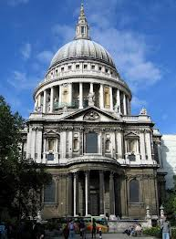
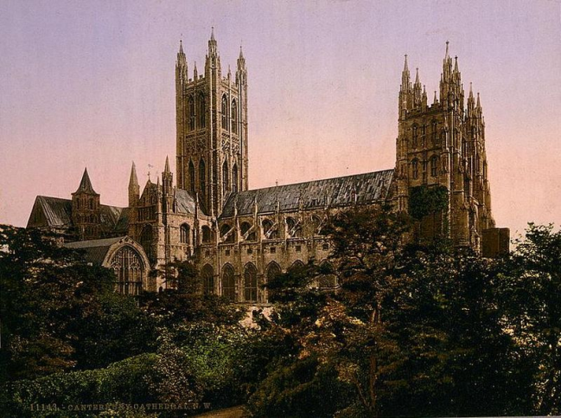
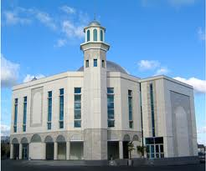
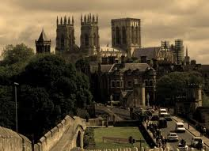
Points of interest in Great Britain
St. Paul's Cathedral Paul in London
Baitul Futuh Mosque
Canterbury Cathedral
York Cathedral

Slide 6
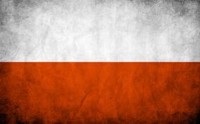
Poland
Unitary state in Central Europe, situated between the Baltic Sea to the north and the Sudeten and Carpathian Mountains to the south, in the basin of the Vistula and Oder. Polish administrative area of 312 679 km ², making it the 70th place in the world and the ninth in Europe. Population of over 38.5 million people, is the most populous 34 place in the world and sixth in the European Union.
Capital is Warsaw

Slide 7
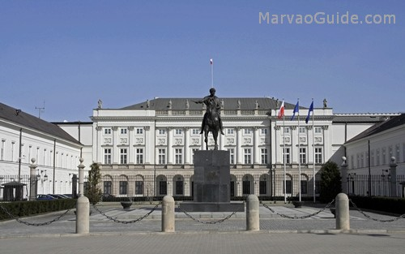
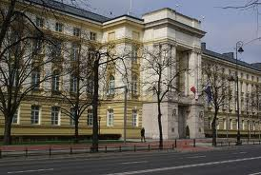
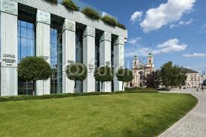
Points of interest in Poland
Prime Minister's Office
Presidential Palace in Warsaw
Supreme Court Building in Warsaw

Slide 8
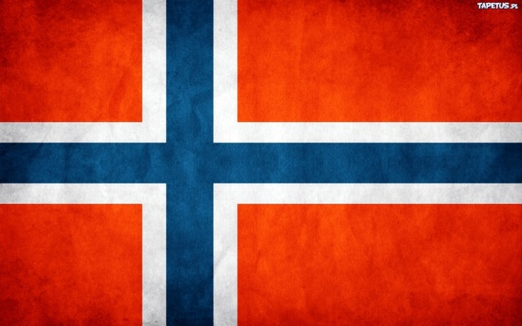
Norway
Officially the Kingdom of Norway is a constitutional monarchy whose territory comprises the western portion of the Scandinavian Peninsula, Jan Mayen, Svalbard and Bouvet Island. It has a total area of ​​385 252 km ² and has a population of about five million people. It is the second least densely populated country in Europe. It borders with Sweden almost the entire length of the border, much shorter lengths separated from Finland, Norway and Russia. The country has also the maritime borderwith Denmark. Long, with more than 20 thousand. kilometers of coastline is known for its distinctive bays, so. fjords. Country name comes from the Old Norse nord Vegen
Capital is Oslo

Slide 9
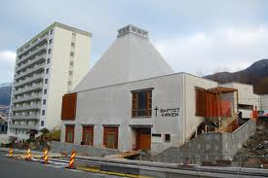
Points of interest in Norway
Baptist Church in Bergen

Slide 10
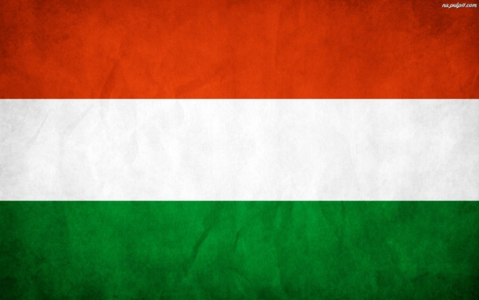
Hungary
The Kingdom of Hungary in 1946, with an episode of the Hungarian People's Republic and the Hungarian Soviet Republic the Republic of Hungary from 1946 to 1949. Following the acquisition of full power by the Communist Party and the creation of one party state dictatorship of the Communist Party, People's Republic of Hungary 1949-1989.
Capital is Budapest

Slide 11
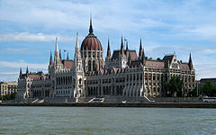
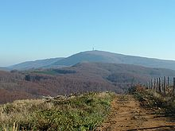
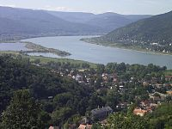
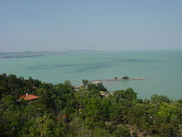
Points of interest in Hungary
The parliament building in Budapest
The highest peak of Hungary - Kékes
Dunaj
Balaton

Slide 12
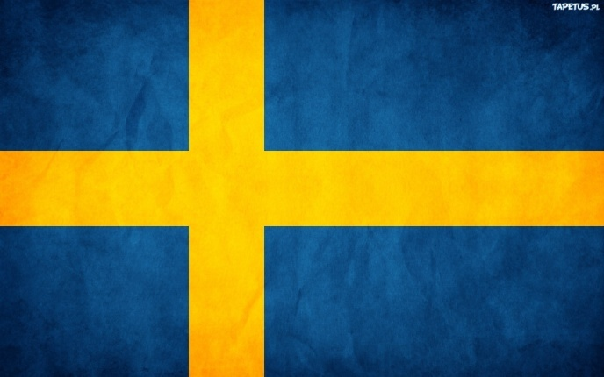
Sweden
Country in Northern Europe, the Scandinavian countries classified. Sweden is a member of the European Union since 1995. It borders with Norway, Finland and Denmark.

Slide 13

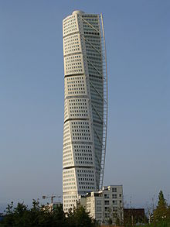
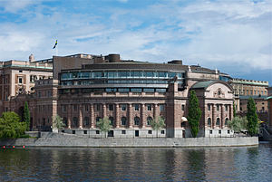
Points of interest in Sweden
University in Göteborg
Turning Torso in Malmö
Swedish Parliament

Slide 14
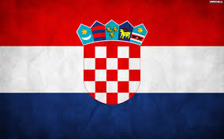
Croatia
A country in Southern Europe, on the Adriatic Sea, bordered on the south of Bosnia and Herzegovina, and Montenegro to the east of Serbia and Hungary and Slovenia to the north. From the south-west has access to the Adriatic Sea.
Capital is Zagrzeb

Slide 15
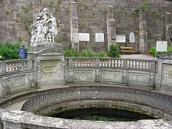
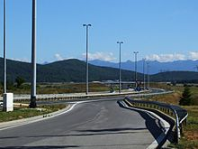
Points of interest in Croatia
"Source of the Danube" in Donaueschingen
The A1 motorway near the town of Gospić

Slide 16
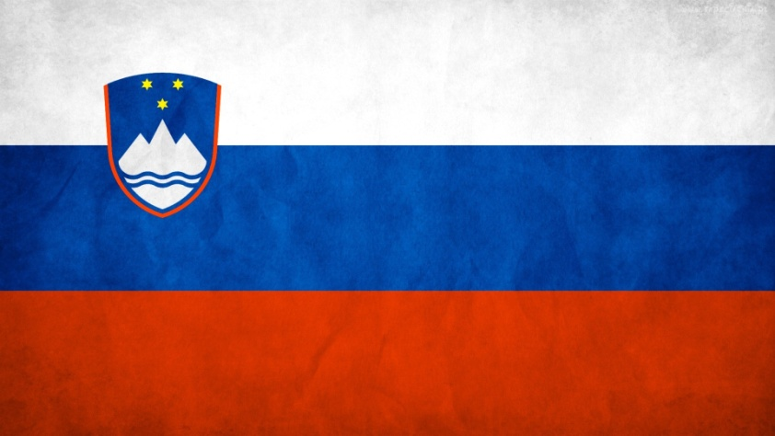
Slovenia
Is a country located in Central Europe, with access to the Adriatic Sea. Slovenia is one of the NATO since March 29, 2004, is also a member of the EU on 1 May 2004.
Capital is Lublana

Slide 17
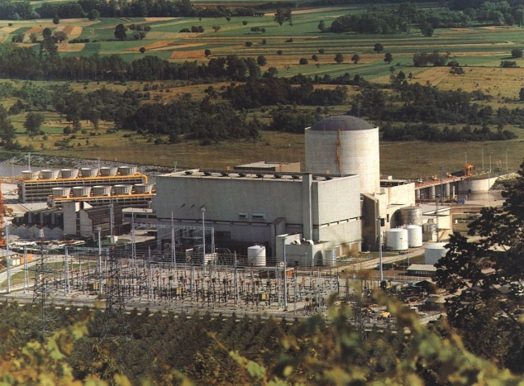
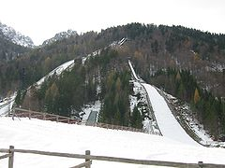
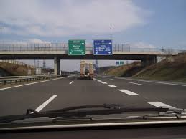
Points of interest in Slovenia
nuclear power plant in Krsko
Jumps in Planica
Expressway H2

Slide 18
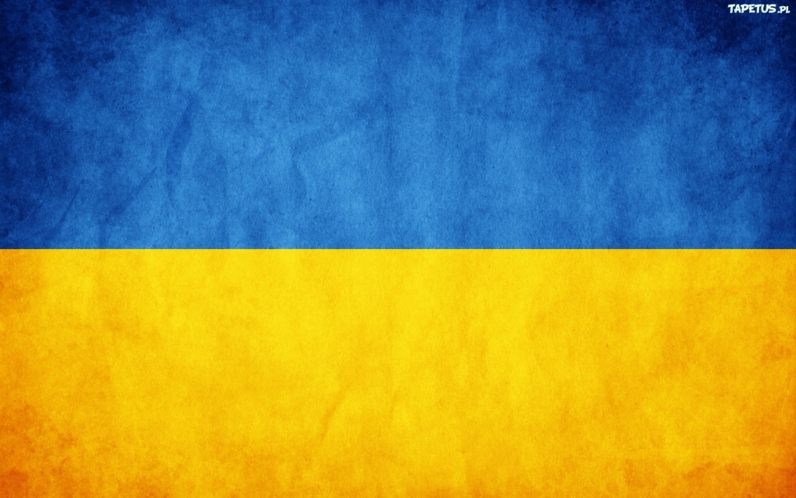
Ukraine
Is a country in Eastern Europe. It is bordered on the north by Belarus, to the west of the Polish, Slovakia and Hungary to the south of Romania and Moldova and the Black Sea and the Azov Sea, north east and east with the Russian Federation.
Capital is Kiev

Slide 19
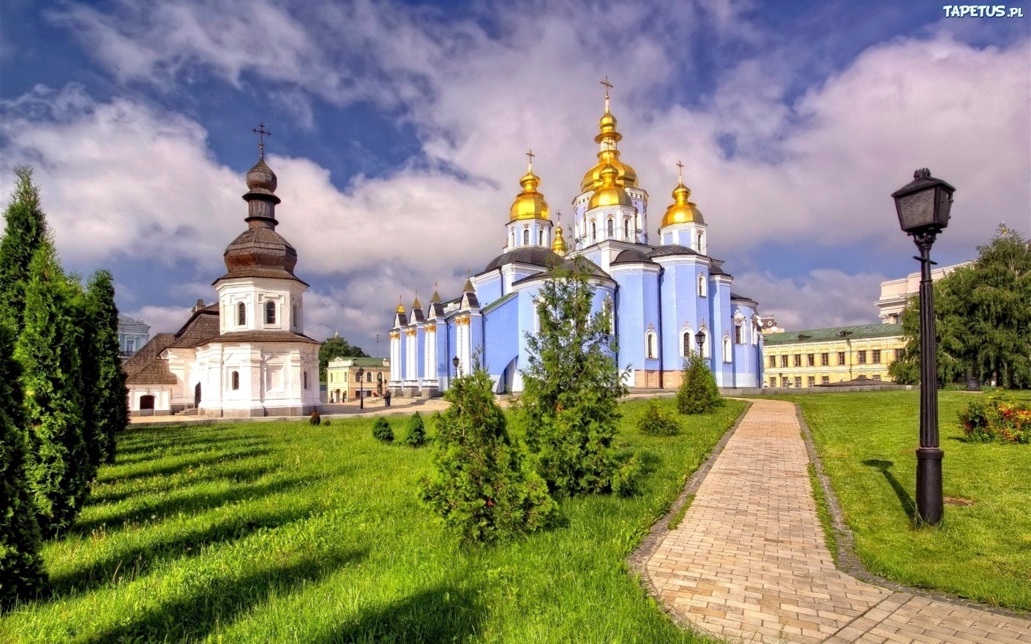
Points of interest in Ukraine
Monastery of St. Michael the Archangel

